Slide 1
ATOMIC ENERGY EDUCATION SOCIETY
DISTANCE LEARNING EDUCATION PROGRAMME
CLASS-VIII MATHEMATICS
UNDERSTANDING QUADRILATERALS (MODULE2/4)

Slide 2

Understanding Quadrilaterals
Module2/4
Let us recall what we have done in the first module.
1) Sum of interior angles of a polygon = (n-2) x 180$°$
2) Measure of each angle of a regular polygon of ‘n’ sides
= $\frac{\left(n−2\right)x180°}{n}$
where ‘n’ is the number of angles or number of sides

Slide 3
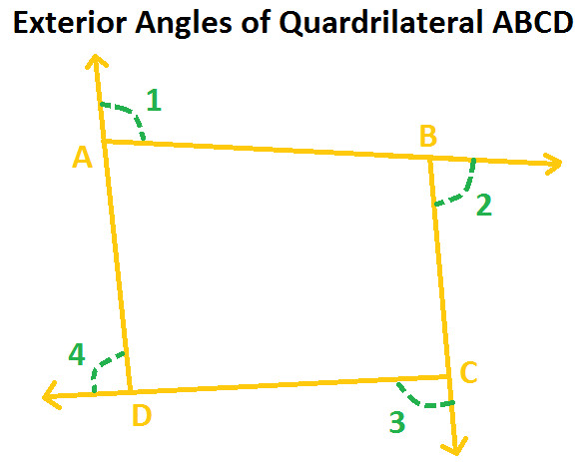
Understanding Quadrilateral
Module2/4
Exterior Angles of a polygon and its sum
Let us see what is an exterior angle of a quadrilateral.
Consider a quadrilateral ABCD.
1)An exterior angle of a quadrilateral is
the angle formed between the extended
side and the side of the quadrilateral
2) At each vertex of the quadrilateral you
get one exterior angle. Hence a quadrilateral
has 4 exterior angles.

Slide 4
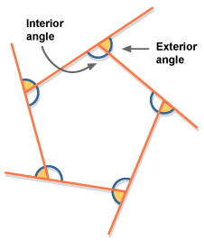

An exterior angle of a polygon
1) In general, a polygon has as many sides
that many exterior angles.
2) A pentagon has 5 exterior angles
As shown in the figure.
3) At each vertex you can see that
sum of interior and exterior angles
is a straight angle i.e. 180$°.$
4) Let us see how to find the sum of the
exterior angles of a polygon

Slide 5
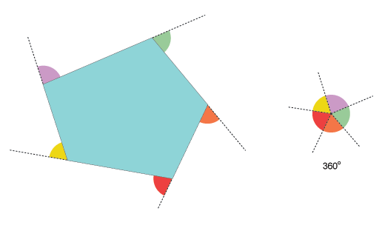


ACTIVITY - Draw a pentagon and its exterior angles. Cut the exterior angles and put all the five angles together as shown below. You get a full circle measure of which is 360$°$
Therefore, sum of the exterior angles of a pentagon = 360$°$

Slide 6

Sum of exterior angles of a triangle.
Let us find the sum of exterior angles of a triangle.
In $∆$ABC, $∠$1 + $∠BAC$ =180$°$ (linear pair of angles) -----(1)
$∠2$ + $∠ABC$ =180$°$ (linear pair of angles) -----(2)
$∠3$ + $∠ACB$ =180$°$ (linear pair of angles) ------(3)
Adding above 3 equations, we get,
$∠$1 + $∠BAC$ + $∠2$ + $∠ABC$ + $∠3$ + $∠ACB$ = 180$°$ + 180$°$ + 180$°$
Rearranging ,we get,
$∠$1 + $∠2$ + $∠3$ + ($∠BAC$ + $∠ABC$ + $∠ACB$) =3 x 180$°$
$∠$1 + $∠2$ + $∠3$ + 180$°$ =540$°$
Or, $∠$1 + $∠2$ + $∠3$ = 540$°$ - 180$°$ =360$°$
So, sum of exterior angles of a triangle = 360$°$

Slide 7

Sum of the exterior angles of a quadrilateral.
In םABCD, $∠$1 + $∠DAB$ =180$°$ (linear pair of angles) -----(1)
$∠2$ + $∠ABC$ =180$°$ (linear pair of angles) -----(2)
$∠3$ + $∠BCD$ =180$°$ (linear pair of angles) -----(3)
$∠4$ + $∠CDA$ =180$°$ (linear pair of angles) -----(4)
Adding all the four equations, we get,
$∠$1 + $∠DAB$ + $∠2$ + $∠ABC$ + $∠3$ + $∠BCD$ + $∠4$ + $∠CDA$ = 4 x 180$°$
Or, $∠$1+ $∠2$+ $∠3$+ $∠4$+ ($∠ABC$ + $∠BCD$ + $∠CDA$ + $∠DAB$ ) = 720$°$
Or, $∠$1+ $∠2$+ $∠3$+ $∠4$+ 360$°$ = 720$°$
Or, $∠$1+ $∠2$+ $∠3$+ $∠4$ = 720$°$ - 360$°$ = 360$°$
Thus, sum of the exterior angles of a quadrilateral = 360$°$

Slide 8

Conclusion – Sum of the exterior angles of a polygon = 360$°$
Problems based on interior and exterior angles of a polygon.
Example 1. Find x in the following figures.
Soln. We know that sum of the exterior
angles of a triangle = 360$°$
Therefore, 125$°$ + 125$°$+ x = 360$°$
Or, 250$°$ + x = 360$°$
Or, x = 360$°$ - 250$°$
Or, x = 110$°$

Slide 9


Example 2.How many sides does a regular polygon have if the measure of an exterior angle is 24$°$
Soln. Let the regular polygon has ‘n’ sides.
m(an exterior angle of a regular polygon) = $\frac{360°}{n}$
24$°$ = $\frac{360°}{n}$
n = $\frac{360°}{\text{24}°}$ = 15
$∴$ number of sides = 15

Slide 10

Example-3. Prove that interior angle of a regular pentagon is three times the exterior angle of a regular decagon.
Soln.Interior angle of a regular pentagon=$\frac{\left(n−2\right)x180°}{n}$
= $\frac{\left(5−2\right)x180°}{5}$
=$\frac{3x180°}{5}$ = $\frac{540°}{5}$
=108$°$

Slide 11
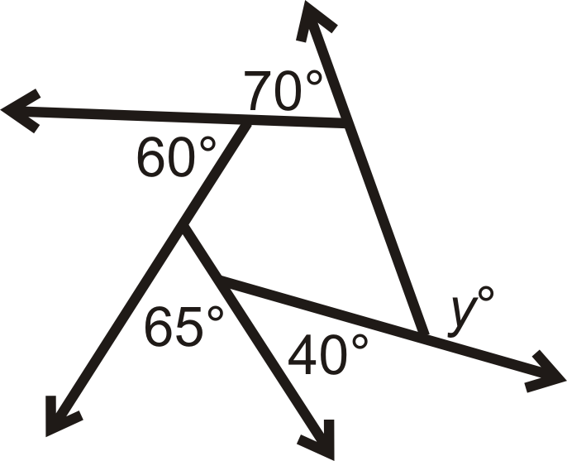


Exterior angle of a decagon = $\frac{360°}{10}$ =36$°$
3 x exterior angle of decagon= 3 x 36$°$ =108$°$
Thus ,interior angle of a pentagon = three times the exterior angle of a decagon.
Example 4. Find ‘y’ in the fig
given aside.
Soln.60$°$+65$°$+40$°$+70$°$ + y =360$°$
y + 235$°$ = 360$°$
y = 360$°$ - 235$°$
y =145$°$

Slide 12
THANK YOU
Made by: Bhavana Dale
T.G.T.(SS)
A.E.C.S.-1 TARAPUR

